Slide 1

OVER VOLTAGES-Simulation of Impulsive Transient Caused By Lightning.
CASE STUDY-1
DEPARTMENT OF EEE
IV year -1semester
Academic year: 2020-2021
Presented By:
18985A0208 – A.SAI SAMPATH
18985A0232 – G.CHINNA
18985A0247 – L.RATNAKARA RAO
18985A0271 – Y.VASUDEVA
FACULTY:
Mr.P.Srinivas
Assistant professor
RAGHU ENGINEERING COLLEGE
(AUTONOMOUS)

Slide 2
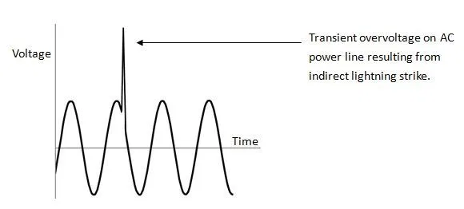
Introduction.
Electronic and electrical devices are designed to operate at a certain maximum supply voltage, and considerable damage can be caused by voltage that is higher than that for which the devices are rated.
When the voltage in a circuit or part of it is raised above its upper design limit, this is known as overvoltage. The conditions may be hazardous. Depending on its duration, the overvoltage event can be transient—a voltage spike—or permanent, leading to a power surge.

Slide 3
Sources of Over Voltages.
Natural
A typical natural source of transient overvoltage events is lightning. Bursts of solar wind following solar flares are also known to cause overvoltage in electrical circuits, especially onboard space satellites.
Man-Made
Man-made sources of spikes are usually caused by electromagnetic induction when switching on or off inductive loads (such as electric motors or electromagnets), or by switching heavy resistive AC loads when zero-crossing circuitry is not used - anywhere a large change of current takes place. One of the purposes of electromagnetic compatibility compliance is to eliminate such sources.
An important potential source of dangerous overvoltage is electronic warfare. There is intensive military research in this field, whose goal is to produce various transient electromagnetic devices designed to generate electromagnetic pulses that will disable an enemy's electronic equipment.

Slide 4
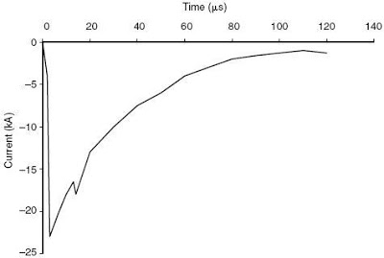
Impulsive Transient.
It is defined by IEEE 1159 as a sudden, non–power frequency change in the steady-state condition of voltage, current, or both that is unidirectional in polarity – either primarily positive or negative. It is normally a single, very high impulse like lightning.
Impulsive transients are not usually transmitted far from the source of where they enter the power system. However, in some cases, they may propagate for some distance along distribution utility lines.

Slide 5
Causes & Effects of Impulsive Transients.
Causes.
Currents produced from a lightning strike can go as high to several thousand amps in about 2-3 μs. Lightning is similar to an intense radio frequency energy, which is an important consideration in the design of grounding and bonding systems.
Electrostatic Discharge is another form of an impulsive transient. The sudden release of charge can damage sensitive electronics. This is the main reason why technicians use wrist straps when servicing electronic equipment.
Effects.
The damage caused by a transient can be immediate (i.e. lightning strike). It can also be gradual as in the case of low-amplitude transients, which slowly degrade equipment insulation making it prone to short circuit. This gradual destruction is sometimes referred to as a “slow death by a thousand cuts”.
Furthermore, impulsive transients can excite power system resonance circuits and produce the other type of transient disturbance - Oscillatory Transients.

Slide 6
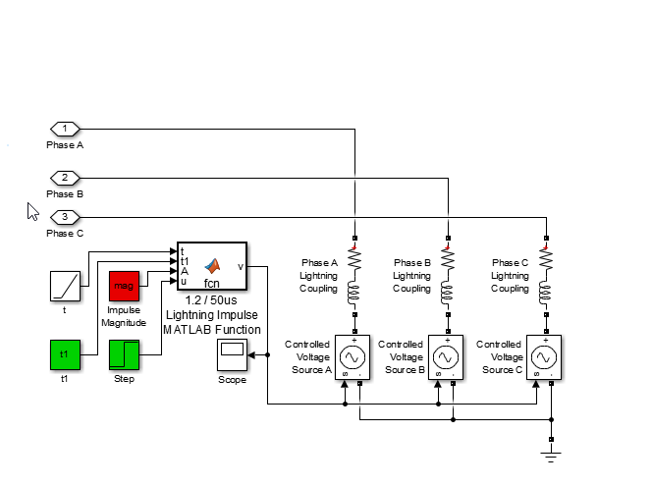
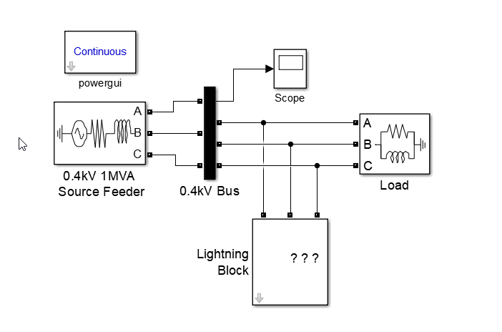
Simulink Model.
Lightning Model.
Lightning Block.

Slide 7
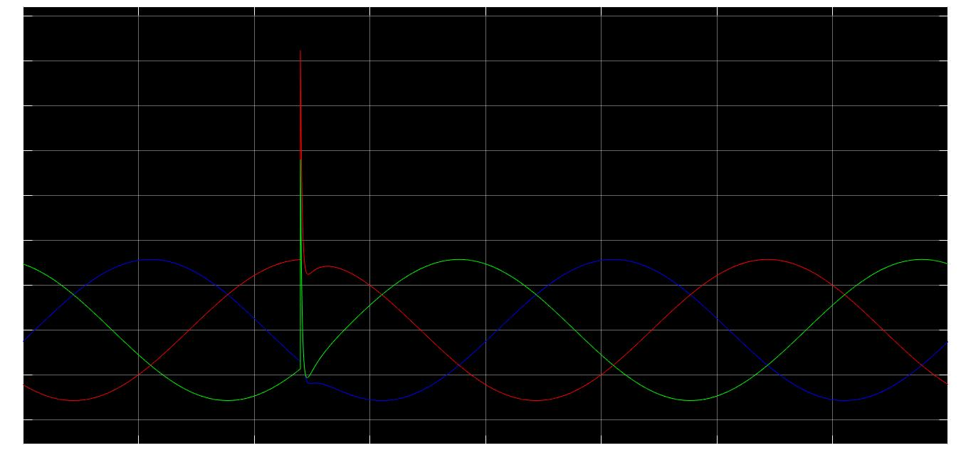
Simulation Results.

Slide 8
Over Voltage Protection Devices.
Arcing horns.
Avalanche diode.
Gas-filled tube.
Lightning rod.
Metal-oxide varistor.
SiBar Thyristor.
Spark gap.
Transient-voltage-suppression diode.
Trisil.
Zener diode.

Slide 9
Conclusion.
The phenomena, effects & causes of over voltages are discussed & impulsive transient due to lightning on a feeder line is simulated in MATLAB-Simulink.
References.
Rodney Tan (2021). Impulsive Transient Caused By Lightning (https://www.mathworks.com/matlabcentral/fileexchange/51934-impulsive-transient-caused-by-lightning), MATLAB Central File Exchange. Retrieved January 26, 2021.

Slide 10
THANK YOU.

